Slide 1
Mean Shift Clustering Algorithm Machine Learning

Slide 2
Agenda
Introduction
MEAN SHIFT
What is MEAN SHIFT
Pictographical Representation
conclusion

Slide 3

Banish J AI Developer, WEB Developer and APP Developer to know more about me check https://www.banish.in/

Slide 4
MEAN SHIFT

Slide 5
What is MEAN SHIFT
Mean Shift clustering works by moving data points towards the center of the cluster
with the help of mean Average.
It keeps shifting the points until they reach the center,
forming clusters around these central points.

Slide 6
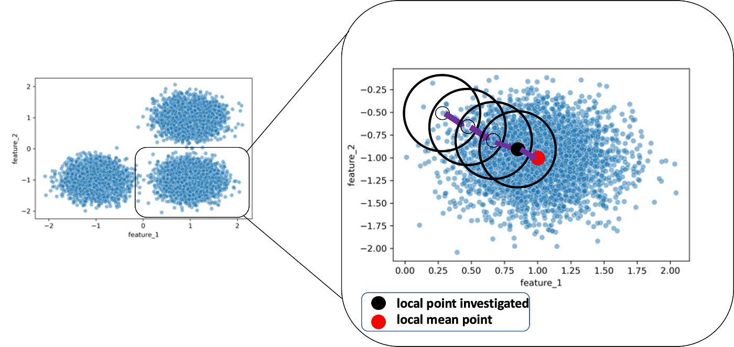
MEAN SHIFT
Average
Movement

Slide 7
Thank you
Banish J
944-433-3914
mail@banish.in
www.banish.in

